Slide 1



DETECTING PHISHING WEBSITE AND
SPAM CONTENT USING MACHINE LEARNING
PROJECT GUIDE
MR.PRASAD N
ASSISTANT PROFESSOR
DEPARTMENT OF INFORMATION TECHNOLOGY
TEAM MEMBERS
ANTHONI THOMAS R [732119205005]
KARTHIKEYAN D [732119205022]
PON PANDIAN P [732119205038]
SEKAR S [732119205047]

Slide 2
ABSTRACT
Now a days we get the message which contains “content” and “link”.
With the rapid growth of internet users, people are using them for illegal and unethical conducts , phishing and fraud.
This project will identify those Spam messages and the Phishing URLs on the messages by using techniques of machine learning.
Apply the algorithm on our datasets and best algorithm is selected for the spam detection having the best precision and accuracy.

Slide 3
INTRODUCTION
Phishing is a type of cyber attack that uses deceptive emails, websites, or text messages to trick users into providing sensitive information.
Web Phishing is a form of cybercrime where criminals attempt to steal sensitive information such as login credentials, credit card details and personal data by disguising themselves as a legitimate entity through a fake website or e-mail.
Web Phishing is a significant threat to Individuals, Businesses and Organizations, it can result in identity theft, financial losses and reputational damage.
Using Machine Learning Algorithms, it is possible to detect phishing URL’s and text by analyzing the content of the messages, URL’s and attachments.

Slide 4
LITERATURE SURVEY
1. Author : Khatod, V., & Jain, P. (2020)
Overview : This paper proposes a hybrid approach for detecting phishing websites using feature
extraction and machine learning.
Model : Random Forest
Accuracy : 98.3%
2. Author : Mani et al (2018)
Overview : The ensemble strategy aided in obtaining a higher accuracy score.
Model : Random Forest, Naive Bayes and SVM
Accuracy : 87.68%

Slide 5
3. Author : Kumar et al (2018)
Overview : For effective spam identification, uses both univariate and multivariate distribution across user ratings.
Model : Random Forest, Naive Bayes, SVM, K-Nearest Neighbor and Decision tree
Accuracy : 76.0%
4. Author : Watcharenwong, Saikaew (2017)
Overview : Social features like comments etc., are combined with textual features yields better results.
Model : Random Forest
Accuracy : 91.3%

Slide 6
5. Author : Dewan, Kumaraguru (2015)
Overview : Automatic identification of spam text is done with 42 features using Machine Learning
techniques.
Model : Random Forest
Accuracy : 86.9%
6. Author : Mohammed et al (2013)
Overview : Instead of using spam trigger words, Which may fail, a lexicon-based approach is used to filter the data.
Model : Naive Bayes, SVM, K-Nearest Neighbor and Decision tree
Accuracy : 85.96%

Slide 7
EXISTING SYSTEM
1. Phish Detect: Phish Detect is an open-source machine learning-based system that uses natural language processing
(NLP)and Machine learning techniques to identify and block phishing emails.
2. FraudLabs Pro: FraudLabs Pro is a machine learning-based fraud detection system that uses a variety of techniques,
including machine learning and pattern recognition, to detect fraudulent transactions.
3. PhishNet: PhishNet is a deep learning-based system that uses convolutional neural networks (CNNs) to detect phishing
websites. One of the drawbacks of PhishNet is that it requires a large amount of training data to achieve high accuracy,
which can be difficult to obtain.

Slide 8
DRAWBACKS OF EXISTING SYSTEM
Lack of Labeled Data
Over Fitting
Adversarial Attacks
False Positives and False Negatives
Limited Interpretability

Slide 9
PROPOSED SYSTEM
Data collection: Collecting a large dataset of labeled examples of both phishing and non-phishing websites,
as well as spam and non-spam emails, is crucial for training and evaluating the KNN classifiers.
Data preprocessing: Preprocessing the collected data involves cleaning the data, removing irrelevant features,
and transforming the data into a format that can be used for training and testing the KNN classifiers.
Feature extraction: Extracting relevant features from the preprocessed data is an important step for training
the KNN classifiers. This could involve extracting features such as the URL length, domain age, use of HTTPS,
and the presence of certain keywords or phrases.
Training the KNN classifiers: Once the features have been extracted, the KNN classifiers can be trained on the
labeled data. The KNN algorithm works by finding the K nearest data points in the feature space to the data point
being classified and assigning it the label that is most common among those K neighbors.
Evaluating the KNN classifiers: After training the KNN classifiers, they should be evaluated on a separate
dataset of labeled examples to assess their accuracy, precision, recall, and F1 score.

Slide 10
ADVANTAGES IN PROPOSED SYSTEM
Easy Implementation
Low Computational Cost
Non-Parametric Approach
Interpretable
Good for Imbalanced Datasets
Can Handle Multi-Class Problems
Chatbot
Registration Mail

Slide 11

SYSTEM SPECIFICATION
HARDWARE SPECIFICATION :
Processor Type
Speed
RAM
Hard disk
Keyboard
Mouse
SOFTWARE SPECIFICATION :
Operating System
:
:
Intelcore i3
3.40 GHZ
:
Min 4GB
:
:
500 GB
101/102 Standard Keys
:
Optical Mouse
:
Windows 10
Tool
Language
:
:
Visual Studio Code, Jupyter, Flask, Bootstrap and IBM Cloud
Python, MySQL, HTML and CSS

Slide 12
MODULES
User Registration and Login
Registration Mail
Profile Page
Spam Text Detection
Phishing URL Detection
Chat Bot

Slide 13

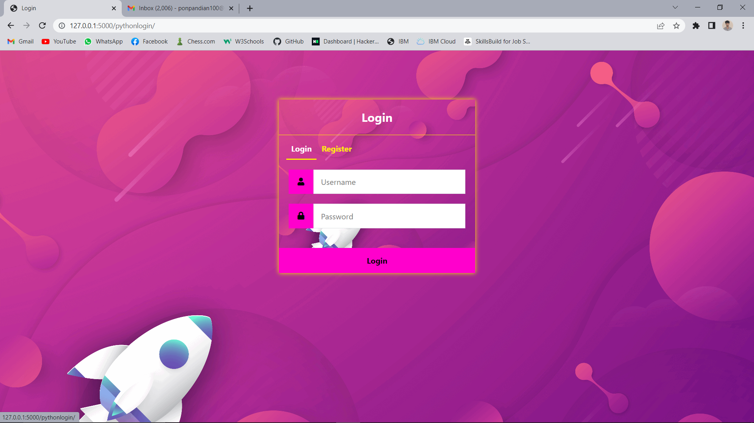
USER REGISTERATION AND LOGIN
In this module, the user authenticate the website by register and login it.
User Registration is required to create new login.
In the registration the user have to give username, E-mail id and password.
These details are stored into the database.
User has to Login after Registering.

Slide 14
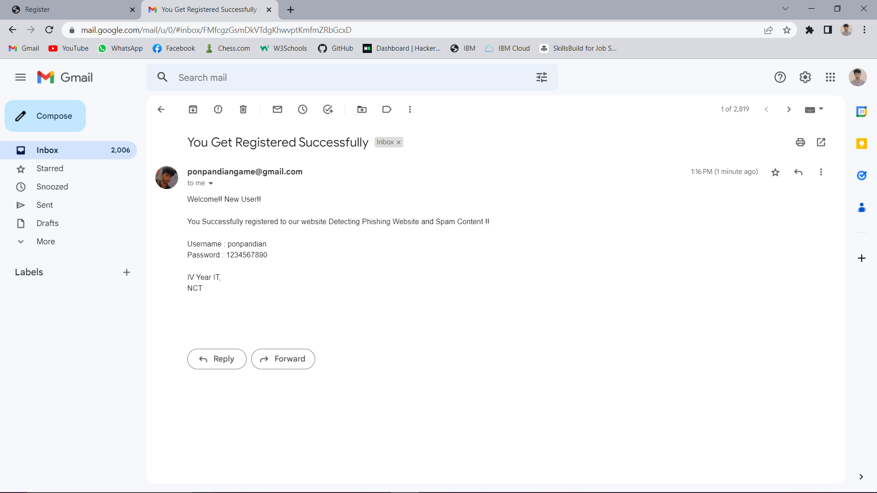
REGISTRATION MAIL
In this module we added one advantage. After successfully complete the Registration the User will receive a registration mail that mail contains the login credentials of the user.

Slide 15
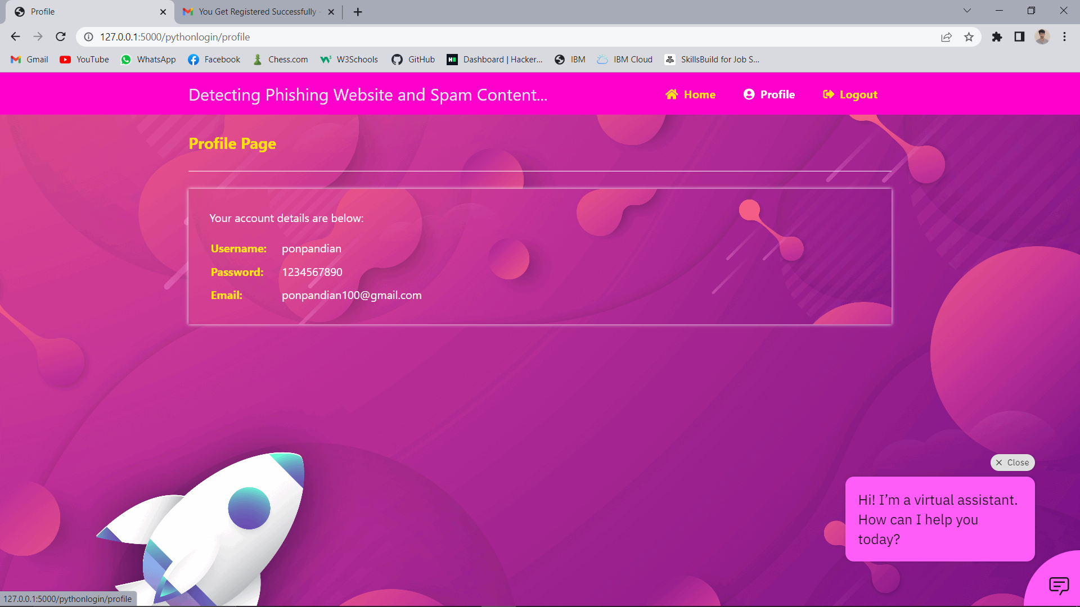
PROFILE PAGE
In our application we includes the profile page here the user can able to see their Personal details like Name, Email Id, Password

Slide 16
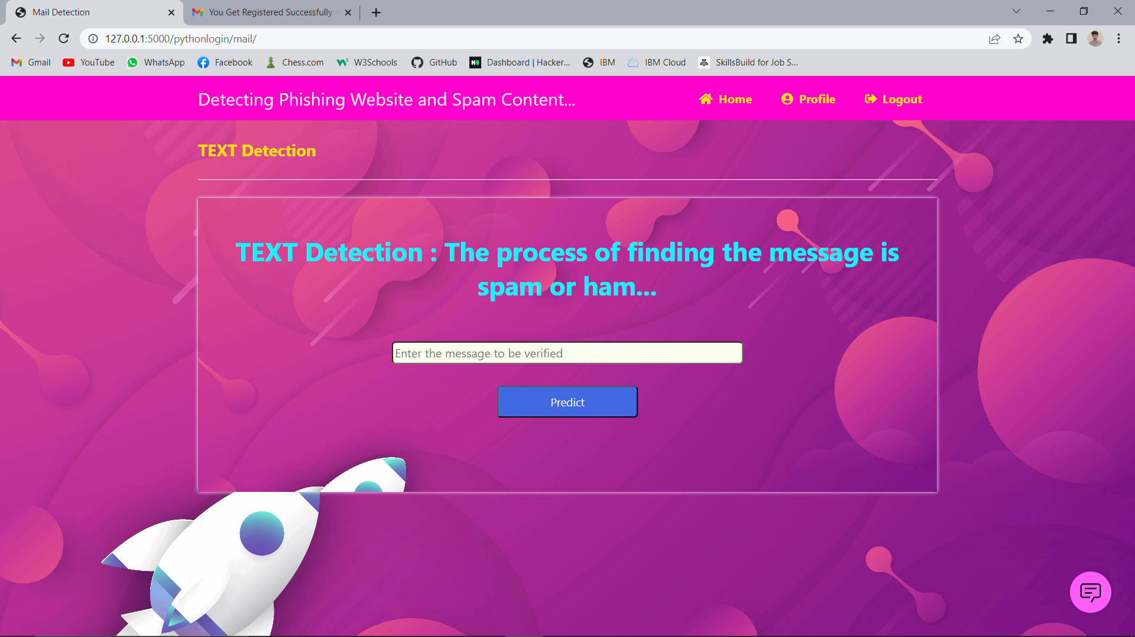
SPAM TEXT DETECTION
In this module, the user can click the Text detection button for to detect the Spam text or Spam content.
After clicking the Button , The user can enter the website content or any other message content in the empty dialog box.
That message content is accepted to detect as Spam content or Normal sentence.

Slide 17

PHISHING URL DETECTION
In this module, the user can click the URL detection button for to detect the Phishing website.
After clicking the Button , The user can enter the website URL or message URL in the empty dialog box.
That URL is taken to detect Whether it is a phishing website or not.

Slide 18
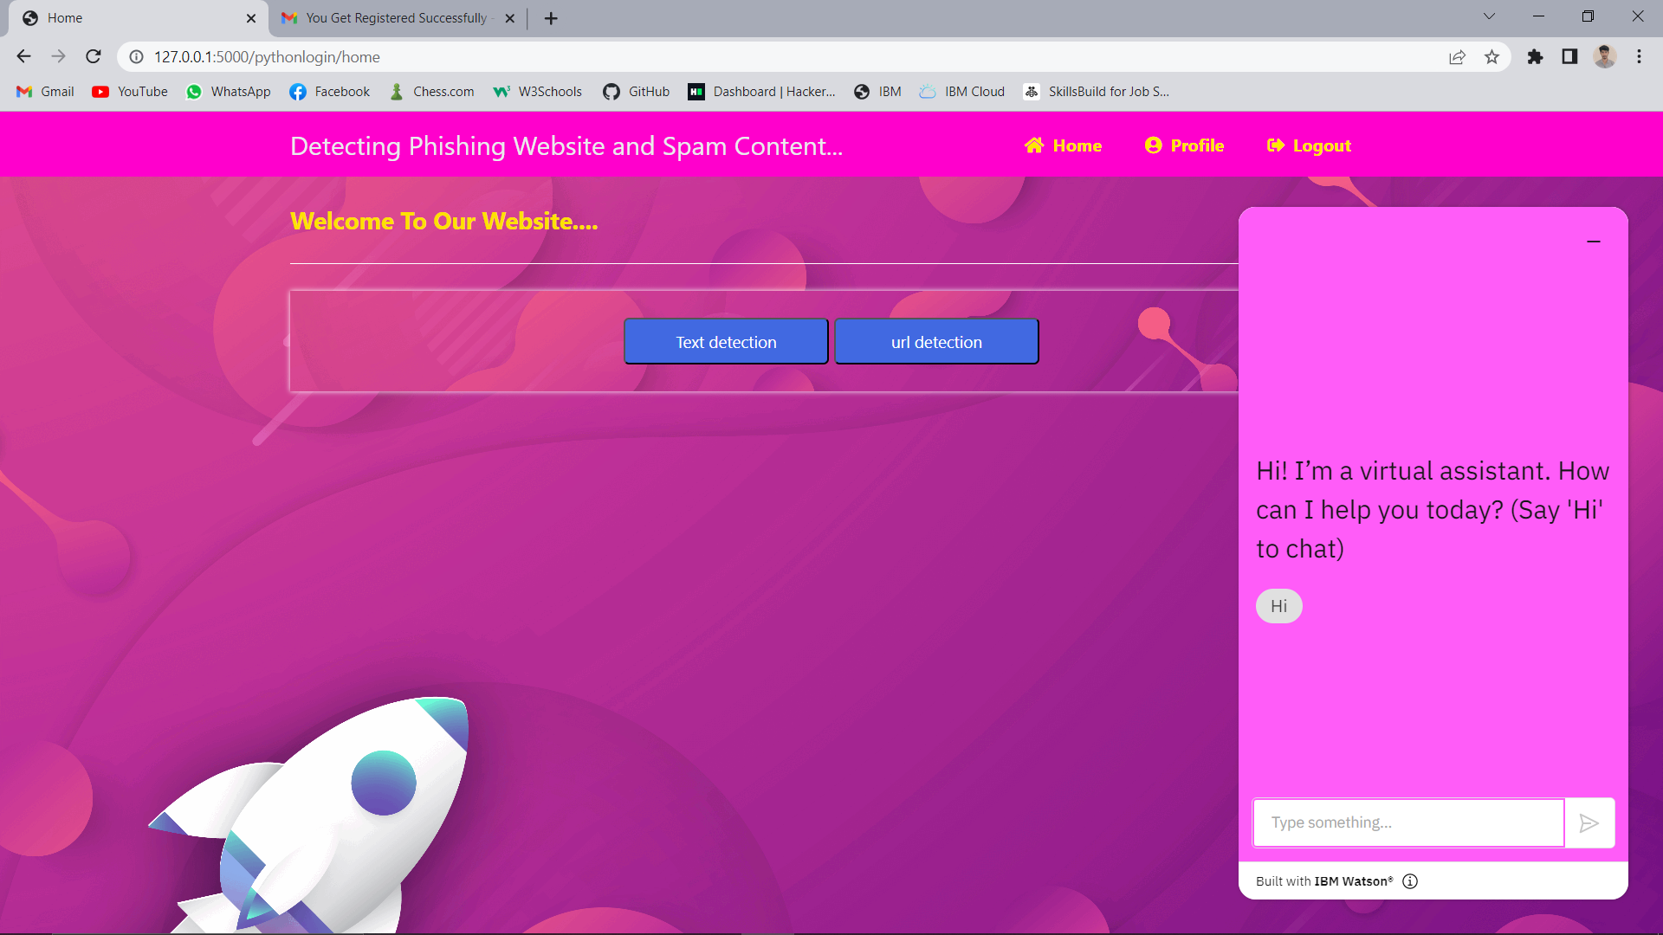
CHATBOT
In this module, the user can click the Chat icon for asking queries. After clicking that icon, the user can ask
their queries by chatting to that bot.

Slide 19
FLOW DIAGRAM
DATASET
PREPROCESSING
ACCURACY
PRECISION
F1- SCORE
ALGORITHMS
RESULT

Slide 20
CONCLUSION
Overall ,the results of the project were promising ,with the KNN classifier demonstrating high accuracy in detecting
Phishing URLs and spam content.
The performance metrics, such as precision , recall and F1 score, showed that the model was able to correctly identify
the majority of phishing URLs and spam content with a relatively low false- positive rate.
FUTURE ENHANCEMENT
Feature Engineering – Feature Engineering is the process of selecting and extracting the most relevant features
from the dataset to improve the performance of the classifier,
In the future ,additional features could be added to the dataset to improve the accuracy of the KNN classifier.

Slide 21
REFERENCES
Almeida, T. A., Gómez Hidalgo, J. M., & Yamakami, A. (2011). Contributions to the study of SMS spam filtering: New collection and results. Journal of Machine Learning Research.
Alzahrani, A., & Yoo, P. D. (2021). Deep learning-based phishing detection techniques: A comprehensive review. Journal of Information Processing Systems.
Bilenko, M., & Mooney, R. J. (2003). Adaptive duplicate detection using learnable string similarity measures. In Proceedings of the 6th International Conference on Discovery Science.
Guzella, T. S., & Caminhas, W. M. (2009). A review of machine learning approaches to spam filtering. Expert Systems with Applications.
Kumar, A., Kant, K., & Gupta, B. B. (2018). A machine learning approach for phishing detection using novel features. Expert Systems with Applications.

Slide 22
6. Li, Y., Li, J., Li, K., & Li, J. (2019). A machine learning-based approach for phishing websites detection. Journal of Intelligent & Fuzzy Systems.
Mani, G. K., Reddy, B. K., & Kumar, G. P. (2018). Hybrid approach for detecting phishing websites using machine learning and rule-based techniques. International Journal of Computer Applications.
Schneider, J., Martinez-Romo, J., & Almeida, T. A. (2017). Toward effective SMS spam filtering: A review of state-of-the-art techniques and trends. IEEE Transactions on Systems, Man and Cybernetics Systems.
Zhang, W., Zhang, H., Hu, B., & Cheng, X. (2017). Deep learning for detecting SMS spam. In 2017 IEEE 14th International Conference on Networking, Sensing and Control (ICNSC).
Zhu, X., & Yao, H. (2019). A phishing detection method based on SVM optimized by particle swarm optimization algorithm. Journal of Ambient Intelligence and Humanized Computing.

